Slide 1
Minimum Edit Distance
Definition of Minimum Edit Distance
Notes:
1

Slide 2
How similar are two strings?
Spell correction
The user typed “graffe”
Which is closest?
graf
graft
grail
giraffe
Computational Biology
Align two sequences of nucleotides
Resulting alignment:
AGGCTATCACCTGACCTCCAGGCCGATGCCC
TAGCTATCACGACCGCGGTCGATTTGCCCGAC
-AGGCTATCACCTGACCTCCAGGCCGA--TGCCC---
TAG-CTATCAC--GACCGC--GGTCGATTTGCCCGAC
Also for Machine Translation, Information Extraction, Speech Recognition
Notes:
1

Slide 3
Edit Distance
The minimum edit distance between two strings
Is the minimum number of editing operations
Insertion (I)
Deletion (D)
Substitution (S)
Needed to transform one into the other
Notes:
1

Slide 4

Minimum Edit Distance
Two strings and their alignment:
Notes:
1

Slide 5
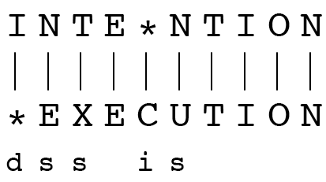
Minimum Edit Distance
If each operation has cost of 1
Distance between these is 5
If substitutions cost 2 (Levenshtein)
Distance between them is 8
Notes:
1

Slide 6
Alignment in Computational Biology
Given a sequence of bases
An alignment:
Given two sequences, align each letter to a letter or gap
AGGCTATCACCTGACCTCCAGGCCGATGCCC
TAGCTATCACGACCGCGGTCGATTTGCCCGAC
-AGGCTATCACCTGACCTCCAGGCCGA--TGCCC---
TAG-CTATCAC--GACCGC--GGTCGATTTGCCCGAC

Slide 7
Other uses of Edit Distance in NLP
Evaluating Machine Translation and speech recognition
R Spokesman confirms senior government adviser was shot
H Spokesman said the senior adviser was shot dead
S I D I
Named Entity Extraction and Entity Coreference
IBM Inc. announced today IBM profits
Stanford President John Hennessy announced yesterday for Stanford University President John Hennessy

Slide 8
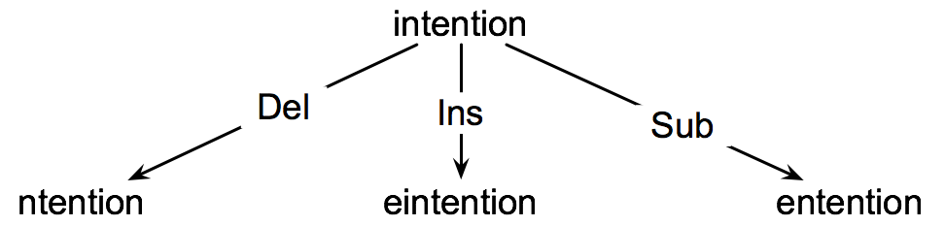
How to find the Min Edit Distance?
Searching for a path (sequence of edits) from the start string to the final string:
Initial state: the word we’re transforming
Operators: insert, delete, substitute
Goal state: the word we’re trying to get to
Path cost: what we want to minimize: the number of edits
1
Notes:
1

Slide 9
Minimum Edit as Search
But the space of all edit sequences is huge!
We can’t afford to navigate naïvely
Lots of distinct paths wind up at the same state.
We don’t have to keep track of all of them
Just the shortest path to each of those revisted states.
1
Notes:
1

Slide 10
Defining Min Edit Distance
For two strings
X of length n
Y of length m
We define D(i,j)
the edit distance between X[1..i] and Y[1..j]
i.e., the first i characters of X and the first j characters of Y
The edit distance between X and Y is thus D(n,m)

Slide 11
Minimum Edit Distance
Definition of Minimum Edit Distance
Notes:
1

Slide 12
Minimum Edit Distance
Computing Minimum Edit Distance
Notes:
1

Slide 13
Dynamic Programming for Minimum Edit Distance
Dynamic programming: A tabular computation of D(n,m)
Solving problems by combining solutions to subproblems.
Bottom-up
We compute D(i,j) for small i,j
And compute larger D(i,j) based on previously computed smaller values
i.e., compute D(i,j) for all i (0 < i < n) and j (0 < j < m)

Slide 14
Defining Min Edit Distance (Levenshtein)
Initialization
D(i,0) = i
D(0,j) = j
Recurrence Relation:
For each i = 1…M
For each j = 1…N
D(i-1,j) + 1
D(i,j)= min D(i,j-1) + 1
D(i-1,j-1) + 2; if X(i) ≠ Y(j)
0; if X(i) = Y(j)
Termination:
D(N,M) is distance

Slide 15
The Edit Distance Table
N | 9
O | 8
I | 7
T | 6
N | 5
E | 4
T | 3
N | 2
I | 1
# | 0 | 1 | 2 | 3 | 4 | 5 | 6 | 7 | 8 | 9
 | # | E | X | E | C | U | T | I | O | N
Notes:
1

Slide 16
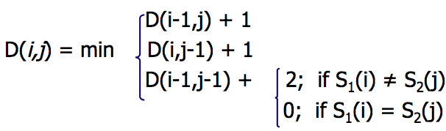
The Edit Distance Table
N | 9
O | 8
I | 7
T | 6
N | 5
E | 4
T | 3
N | 2
I | 1
# | 0 | 1 | 2 | 3 | 4 | 5 | 6 | 7 | 8 | 9
 | # | E | X | E | C | U | T | I | O | N
Notes:
1

Slide 17
Edit Distance
N | 9
O | 8
I | 7
T | 6
N | 5
E | 4
T | 3
N | 2
I | 1
# | 0 | 1 | 2 | 3 | 4 | 5 | 6 | 7 | 8 | 9
 | # | E | X | E | C | U | T | I | O | N
Notes:
1

Slide 18
The Edit Distance Table
N | 9 | 8 | 9 | 10 | 11 | 12 | 11 | 10 | 9 | 8
O | 8 | 7 | 8 | 9 | 10 | 11 | 10 | 9 | 8 | 9
I | 7 | 6 | 7 | 8 | 9 | 10 | 9 | 8 | 9 | 10
T | 6 | 5 | 6 | 7 | 8 | 9 | 8 | 9 | 10 | 11
N | 5 | 4 | 5 | 6 | 7 | 8 | 9 | 10 | 11 | 10
E | 4 | 3 | 4 | 5 | 6 | 7 | 8 | 9 | 10 | 9
T | 3 | 4 | 5 | 6 | 7 | 8 | 7 | 8 | 9 | 8
N | 2 | 3 | 4 | 5 | 6 | 7 | 8 | 7 | 8 | 7
I | 1 | 2 | 3 | 4 | 5 | 6 | 7 | 6 | 7 | 8
# | 0 | 1 | 2 | 3 | 4 | 5 | 6 | 7 | 8 | 9
 | # | E | X | E | C | U | T | I | O | N
Notes:
1

Slide 19
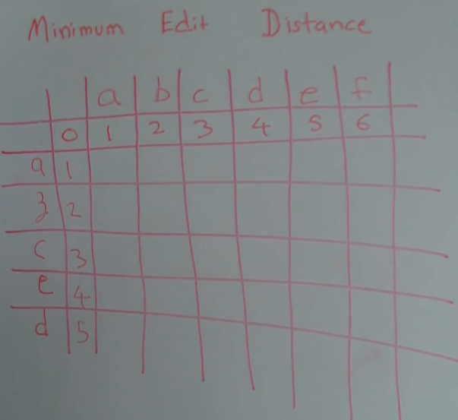

Slide 20
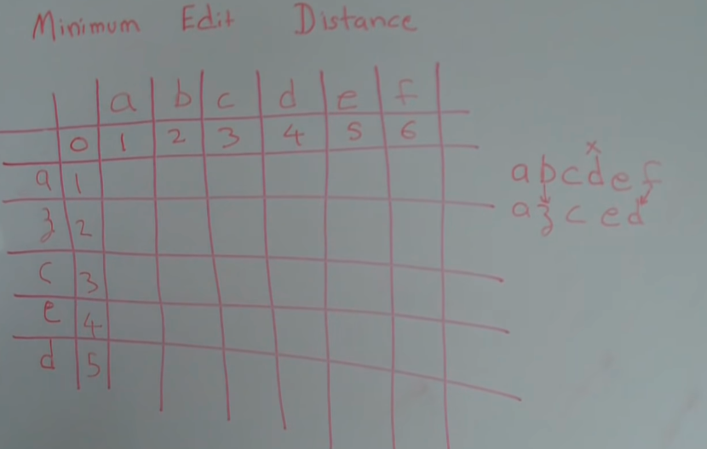

Slide 21
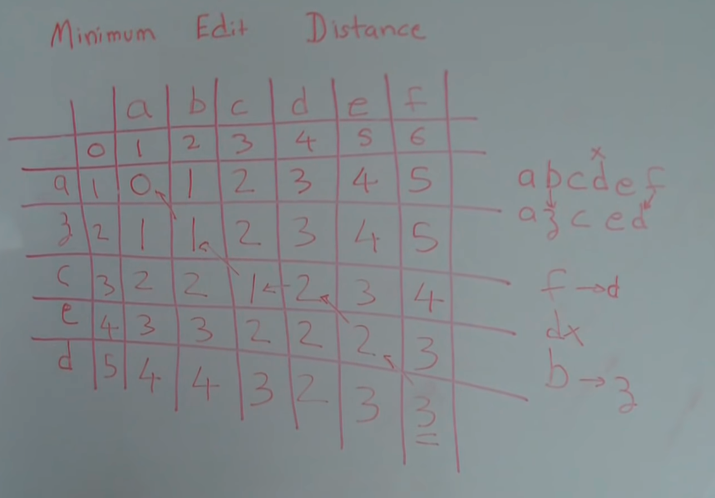

Slide 22
Minimum Edit Distance
Computing Minimum Edit Distance
Notes:
1

Slide 23
Minimum Edit Distance
Backtrace for Computing Alignments
Notes:
1

Slide 24
Computing alignments
Edit distance isn’t sufficient
We often need to align each character of the two strings to each other
We do this by keeping a “backtrace”
Every time we enter a cell, remember where we came from
When we reach the end,
Trace back the path from the upper right corner to read off the alignment
Notes:
1

Slide 25
Edit Distance
N | 9
O | 8
I | 7
T | 6
N | 5
E | 4
T | 3
N | 2
I | 1
# | 0 | 1 | 2 | 3 | 4 | 5 | 6 | 7 | 8 | 9
 | # | E | X | E | C | U | T | I | O | N
Notes:
1

Slide 26
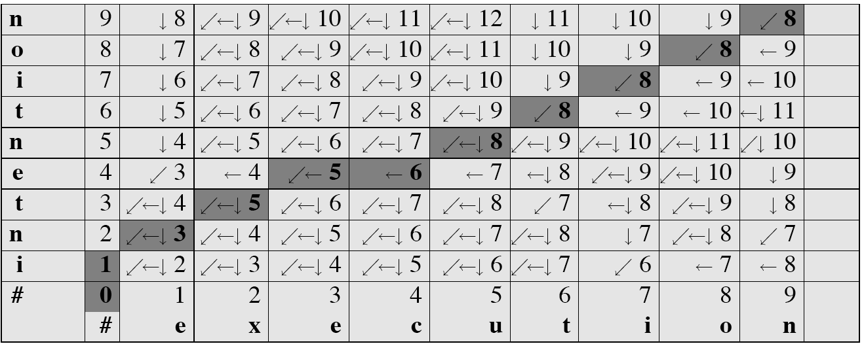
MinEdit with Backtrace

Slide 27
Adding Backtrace to Minimum Edit Distance
Base conditions: Termination:
D(i,0) = i D(0,j) = j D(N,M) is distance
Recurrence Relation:
For each i = 1…M
For each j = 1…N
D(i-1,j) + 1
D(i,j)= min D(i,j-1) + 1
D(i-1,j-1) + 2; if X(i) ≠ Y(j)
0; if X(i) = Y(j)
LEFT
ptr(i,j)= DOWN
DIAG
deletion
insertion
substitution
insertion
deletion
substitution

Slide 28
The Distance Matrix
Every non-decreasing path
from (0,0) to (M, N)
corresponds to
an alignment
of the two sequences
x₀ …………………… x_{N}
An optimal alignment is composed of optimal subalignments
y₀ ……………………………… y_{M}
Slide adapted from Serafim Batzoglou
Notes:
1

Slide 29
Result of Backtrace
Two strings and their alignment:
Notes:
1

Slide 30
Performance
Time:
O(nm)
Space:
O(nm)
Backtrace
O(n+m)
Notes:
1

Slide 31
Minimum Edit Distance
Backtrace for Computing Alignments
Notes:
1

Slide 32
Minimum Edit Distance
Weighted Minimum Edit Distance
Notes:
1

Slide 33
Weighted Edit Distance
Why would we add weights to the computation?
Spell Correction: some letters are more likely to be mistyped than others
Biology: certain kinds of deletions or insertions are more likely than others
Notes:
1

Slide 34
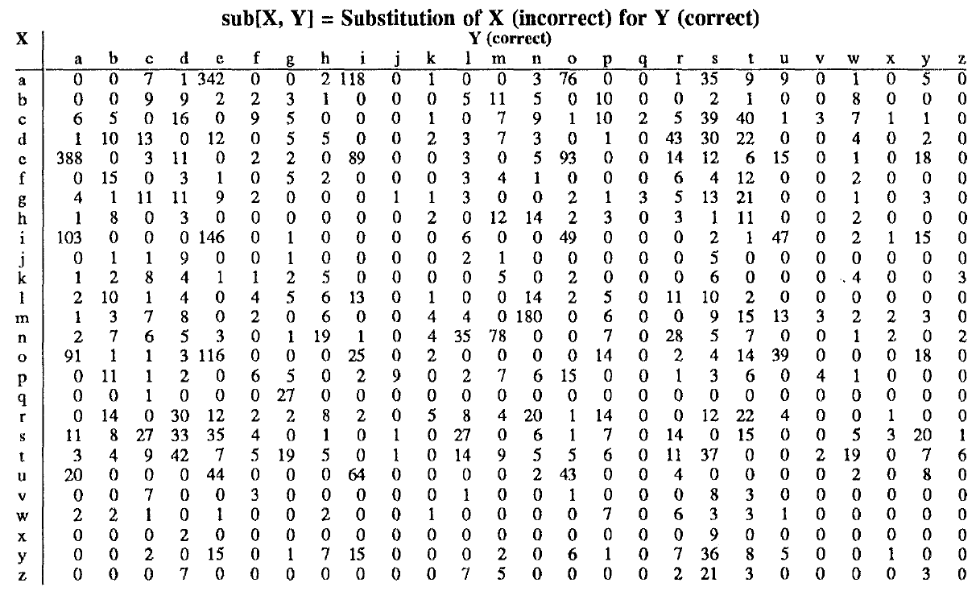
Confusion matrix for spelling errors

Slide 35
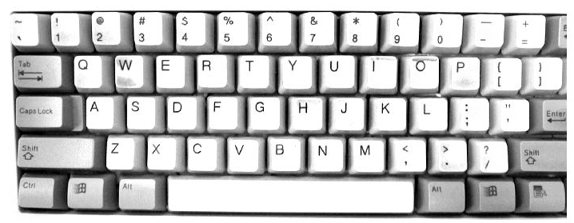

Slide 36
Weighted Min Edit Distance
Initialization:
D(0,0) = 0
D(i,0) = D(i-1,0) + del[x(i)]; 1 < i ≤ N
D(0,j) = D(0,j-1) + ins[y(j)]; 1 < j ≤ M
Recurrence Relation:
D(i-1,j) + del[x(i)]
D(i,j)= min D(i,j-1) + ins[y(j)]
D(i-1,j-1) + sub[x(i),y(j)]
Termination:
D(N,M) is distance
Notes:
1

Slide 37
Where did the name, dynamic programming, come from?
…The 1950s were not good years for mathematical research. [the] Secretary of Defense …had a pathological fear and hatred of the word, research…
I decided therefore to use the word, “programming”.
I wanted to get across the idea that this was dynamic, this was multistage… I thought, let’s … take a word that has an absolutely precise meaning, namely dynamic… it’s impossible to use the word, dynamic, in a pejorative sense. Try thinking of some combination that will possibly give it a pejorative meaning. It’s impossible.
Thus, I thought dynamic programming was a good name. It was something not even a Congressman could object to.”
Richard Bellman, “Eye of the Hurricane: an autobiography” 1984.

Slide 38
Minimum Edit Distance
Weighted Minimum Edit Distance
Notes:
1

Slide 39
Minimum Edit Distance
Minimum Edit Distance in Computational Biology
Notes:
1

Slide 40
Sequence Alignment
AGGCTATCACCTGACCTCCAGGCCGATGCCC
TAGCTATCACGACCGCGGTCGATTTGCCCGAC
-AGGCTATCACCTGACCTCCAGGCCGA--TGCCC---
TAG-CTATCAC--GACCGC--GGTCGATTTGCCCGAC
Notes:
1

Slide 41
Why sequence alignment?
Comparing genes or regions from different species
to find important regions
determine function
uncover evolutionary forces
Assembling fragments to sequence DNA
Compare individuals to looking for mutations

Slide 42
Alignments in two fields
In Natural Language Processing
We generally talk about distance (minimized)
And weights
In Computational Biology
We generally talk about similarity (maximized)
And scores

Slide 43
The Needleman-Wunsch Algorithm
Initialization:
D(i,0) = -i * d
D(0,j) = -j * d
Recurrence Relation:
D(i-1,j) - d
D(i,j)= min D(i,j-1) - d
D(i-1,j-1) + s[x(i),y(j)]
Termination:
D(N,M) is distance
Notes:
1

Slide 44
The Needleman-Wunsch Matrix
x₁ ……………………………… x_{M}
(Note that the origin is at the upper left.)
y₁ …………………… y_{N}
Slide adapted from Serafim Batzoglou
Notes:
1

Slide 45
A variant of the basic algorithm:
Maybe it is OK to have an unlimited # of gaps in the beginning and end:
----------CTATCACCTGACCTCCAGGCCGATGCCCCTTCCGGC
GCGAGTTCATCTATCAC--GACCGC--GGTCG--------------
If so, we don’t want to penalize gaps at the ends
Slide from Serafim Batzoglou
Notes:
1

Slide 46
Different types of overlaps
Example:
2 overlapping“reads” from a
sequencing project
Example:
Search for a mouse gene
within a human chromosome
Slide from Serafim Batzoglou
Notes:
1

Slide 47
The Overlap Detection variant
x₁ ……………………………… x_{M}
Changes:
Initialization
For all i, j,
F(i, 0) = 0
F(0, j) = 0
Termination
max_{i} F(i, N)
F_{OPT} = max
max_{j} F(M, j)
y₁ …………………… y_{N}
Slide from Serafim Batzoglou
Notes:
<number>

Slide 48
The Local Alignment Problem
Given two strings x = x₁……x_{M},
y = y₁……y_{N}
Find substrings x’, y’ whose similarity
(optimal global alignment value)
is maximum
x = aaaacccccggggtta
y = ttcccgggaaccaacc
Slide from Serafim Batzoglou
Notes:
<number>

Slide 49
The Smith-Waterman algorithm
Idea: Ignore badly aligning regions
Modifications to Needleman-Wunsch:
Initialization: F(0, j) = 0
F(i, 0) = 0
0
Iteration: F(i, j) = max F(i – 1, j) – d
F(i, j – 1) – d
F(i – 1, j – 1) + s(x_{i}, y_{j})
Slide from Serafim Batzoglou
Notes:
<number>

Slide 50
The Smith-Waterman algorithm
Termination:
If we want the best local alignment…
F_{OPT} = max_{i,j} F(i, j)
Find F_{OPT} and trace back
If we want all local alignments scoring > t
?? For all i, j find F(i, j) > t, and trace back?
Complicated by overlapping local alignments
Slide from Serafim Batzoglou
Notes:
<number>

Slide 51
Local alignment example
 |  | A | T | T | A | T | C
 | 0 | 0 | 0 | 0 | 0 | 0 | 0
A | 0
T | 0
C | 0
A | 0
T | 0
X = ATCAT
Y = ATTATC
Let:
m = 1 (1 point for match)
d = 1 (-1 point for del/ins/sub)

Slide 52
Local alignment example
 |  | A | T | T | A | T | C
 | 0 | 0 | 0 | 0 | 0 | 0 | 0
A | 0 | 1 | 0 | 0 | 1 | 0 | 0
T | 0 | 0 | 2 | 1 | 0 | 2 | 0
C | 0 | 0 | 1 | 1 | 0 | 1 | 3
A | 0 | 1 | 0 | 0 | 2 | 1 | 2
T | 0 | 0 | 2 | 0 | 1 | 3 | 2
X = ATCAT
Y = ATTATC

Slide 53
Local alignment example
 |  | A | T | T | A | T | C
 | 0 | 0 | 0 | 0 | 0 | 0 | 0
A | 0 | 1 | 0 | 0 | 1 | 0 | 0
T | 0 | 0 | 2 | 1 | 0 | 2 | 0
C | 0 | 0 | 1 | 1 | 0 | 1 | 3
A | 0 | 1 | 0 | 0 | 2 | 1 | 2
T | 0 | 0 | 2 | 0 | 1 | 3 | 2
X = ATCAT
Y = ATTATC

Slide 54
Local alignment example
 |  | A | T | T | A | T | C
 | 0 | 0 | 0 | 0 | 0 | 0 | 0
A | 0 | 1 | 0 | 0 | 1 | 0 | 0
T | 0 | 0 | 2 | 1 | 0 | 2 | 0
C | 0 | 0 | 1 | 1 | 0 | 1 | 3
A | 0 | 1 | 0 | 0 | 2 | 1 | 2
T | 0 | 0 | 2 | 0 | 1 | 3 | 2
X = ATCAT
Y = ATTATC

Slide 55
Minimum Edit Distance
Minimum Edit Distance in Computational Biology
Notes:
<number>

